Slide 1
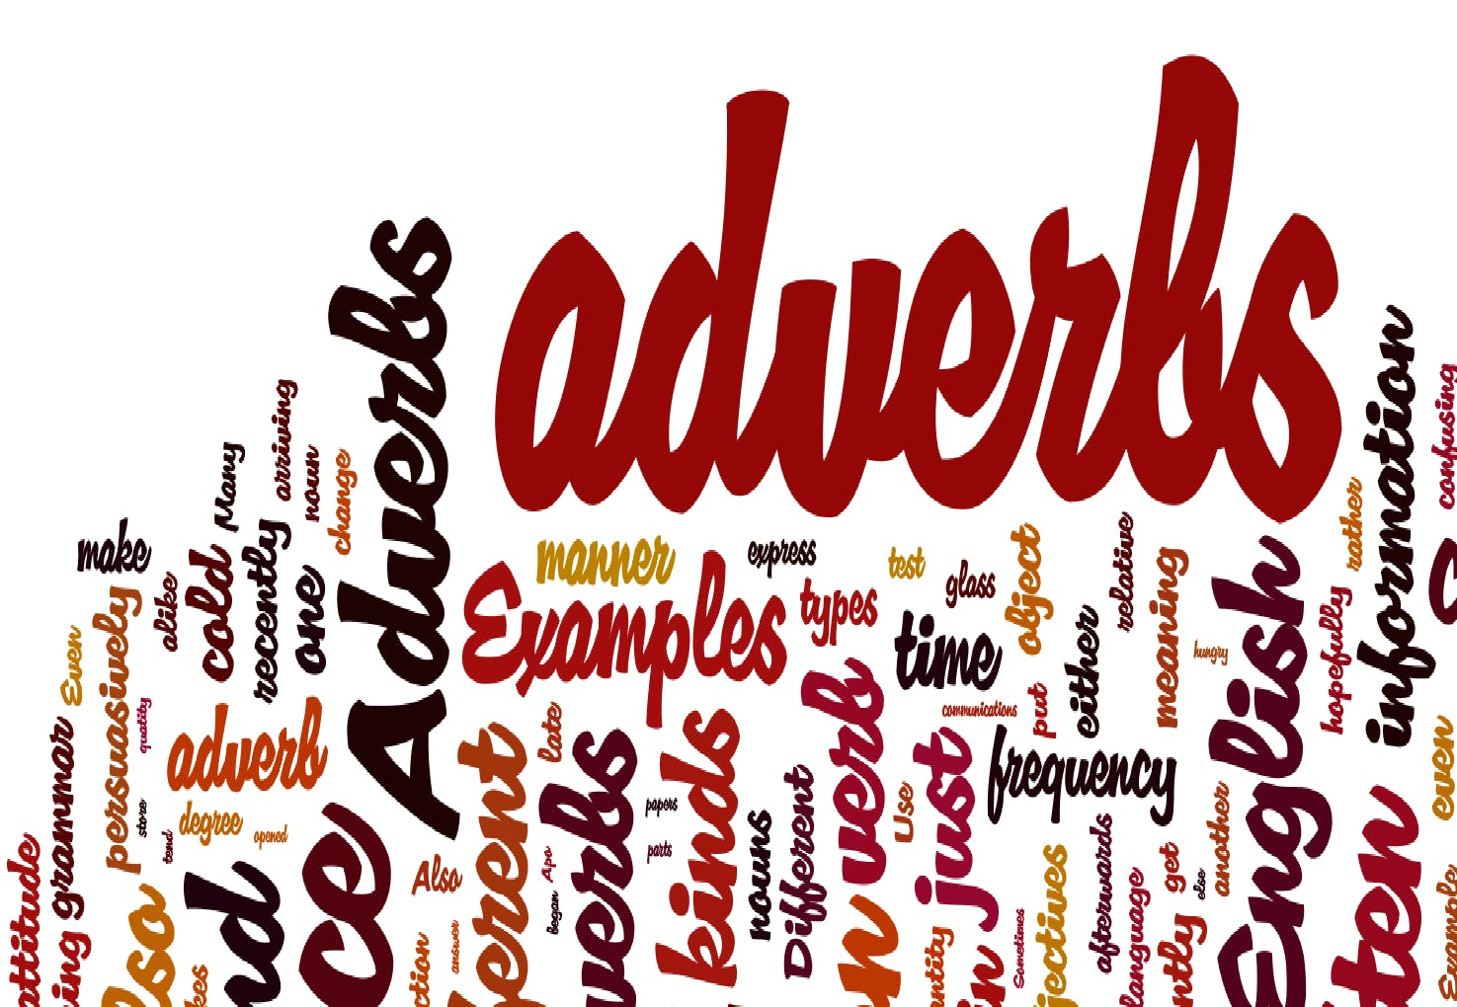

Slide 2
What is an adverb?

Slide 3
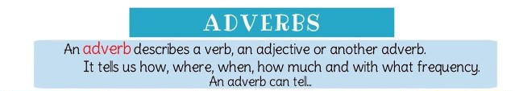
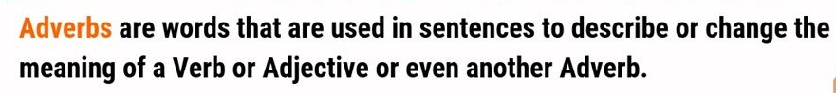

Slide 4
Place
Time
Manner

Slide 5
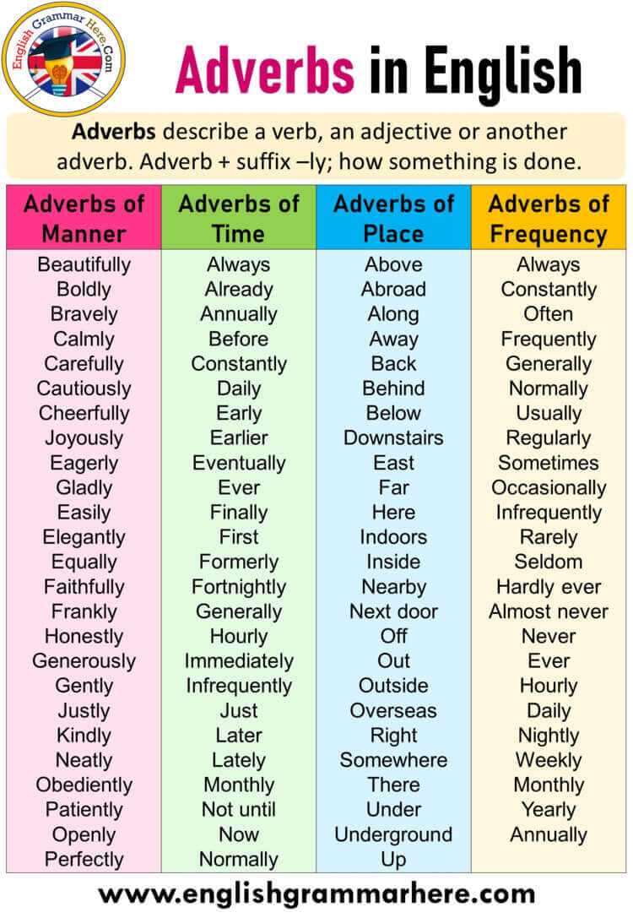
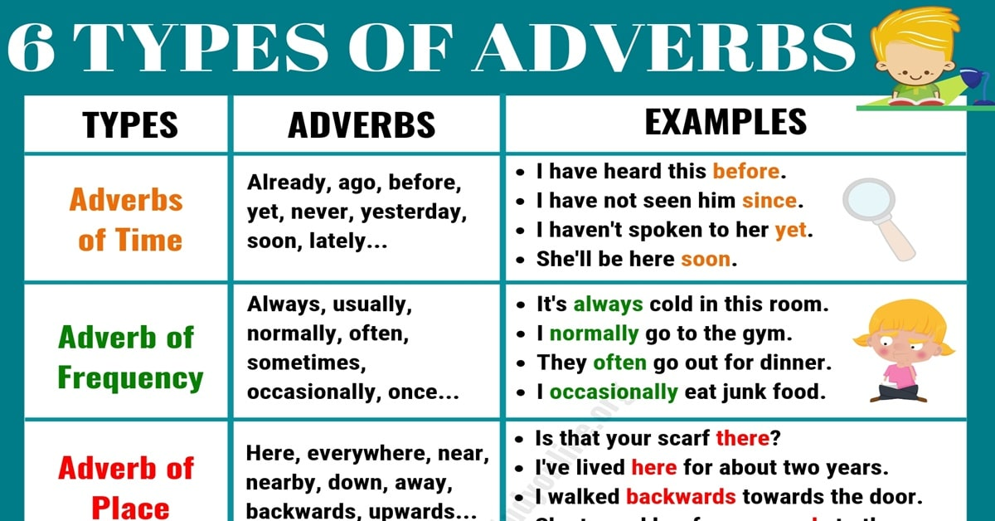
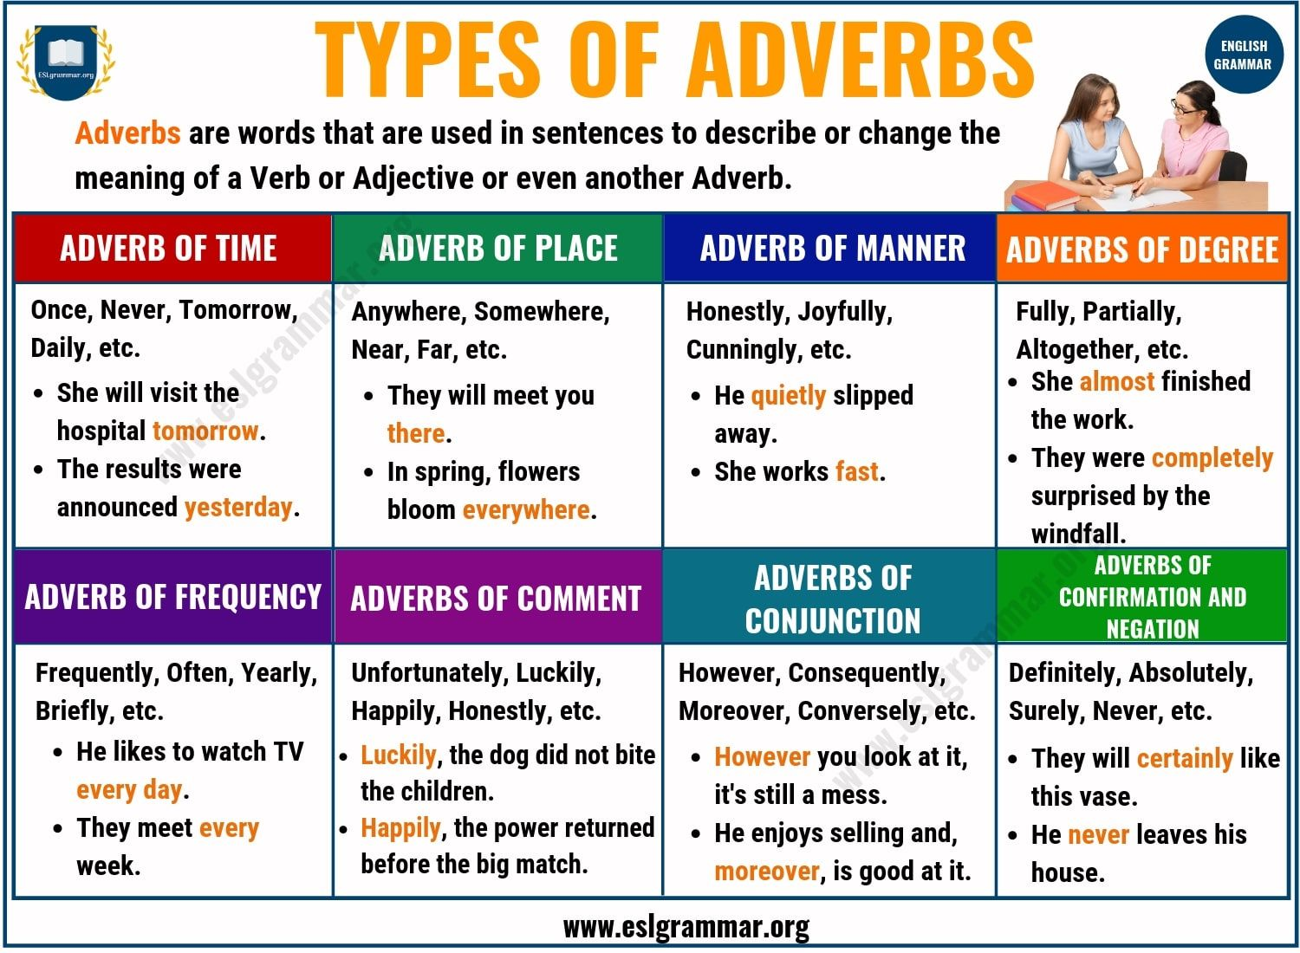
WHERE?

Slide 6
WHEN?

Slide 7
HOW?

Slide 8
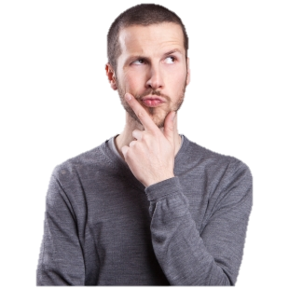
SO WHAT IS AN ADVERBIAL PHRASE?
An adverbial phrase is a group of words that functions as an adverb.
An adverbial phrase is a group of words that have the same impact as an adverb. They modify a verb, adjective, adverb, clause or an entire sentence.
Jack will sit in silence.
(The adverbial phrase "in silence" is functioning as an adverb of manner. It tells us how Jack sat.)
Compare the example above with these examples:
Jack will sit quietly.
(This is a normal adverb of only one word)

Slide 9
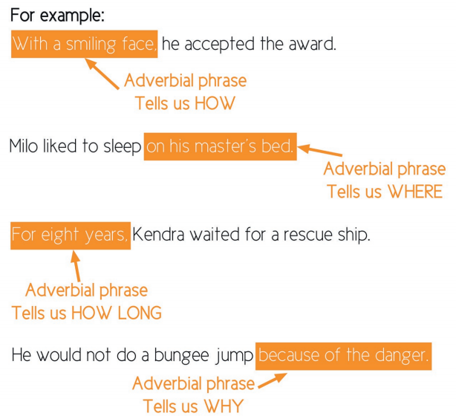

Slide 10
ADVERBIAL PHRASE OF TIME
EXAMPLES:
I'll do it in a minute.
Dad got home very late.
Meet me at the mall later this evening.
An adverbial phrase of time states when something happens or how often
Any time
Yesterday afternoon
After a few minutes

Slide 11
ADVERBIAL PHRASE OF PLACE
EXAMPLES:
The bees flew through the air.
I parked the car right here.
I parked the car right here under the bridge.
Sometimes I don't clean under the bed.
Near the edge
Through the looking glass
Behind the wall
In the room

Slide 12
ADVERBIAL PHRASE OF MANNER
An adverbial phrase of manner states how something is done.
EXAMPLES:
We walked very carefully across the floor.
He made his decision as quickly as possible.
Truly happy, I gave him my answer.
The children opened their presents with excitement.
Surprisingly well
In total silence
Very carefully
Quite easily
Very rudely

Slide 13
ADVERBIAL PHRASE OF REASON
An adverbial phrase of reason states why something is done.
Adverb clauses of cause or reason are introduced by the subordinating conjunctions because, as, since and that.
EXAMPLES:
I sing because I like singing.
He thinks he can get anything because he is rich.
Since he has apologized we will take no further action against him.
As he was not there I left a message with his mother.
I am glad that you have come.
My parents were disappointed that I didn’t get the scholarship.
He was furious that his book was panned by most reviewers
She eats healthy and goes to the gym in order to have a great body.

Slide 14
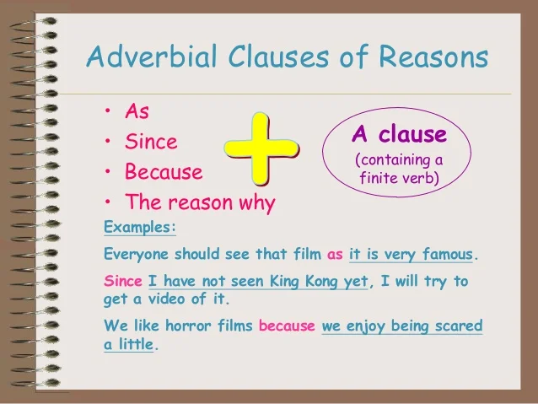
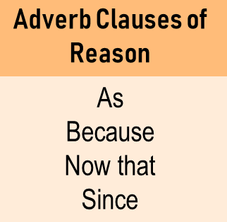
ADVERBIAL PHRASE OF REASON

Slide 15
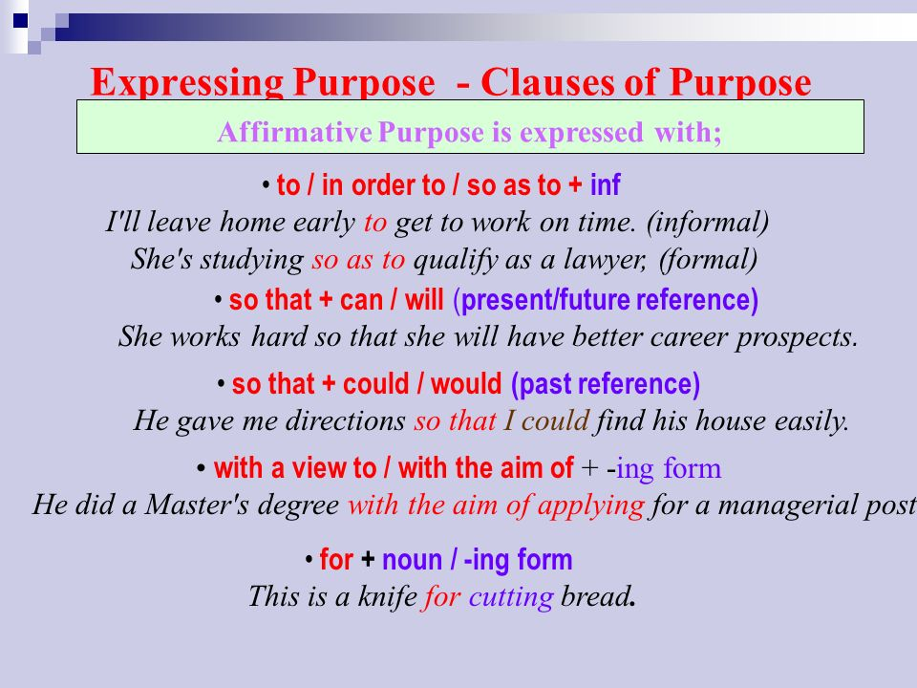
ADVERBIAL PHRASE OF PURPOSE

Slide 16
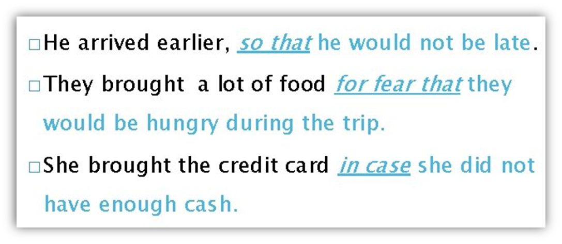
ADVERBIAL PHRASE OF PURPOSE

Slide 17
SOURCES
https://theresiaingangela.files.wordpress.com/2015/10/adverb-and-adverbial-phrase.pdf
(pdf document with explanation of adverbs and adverbial phrases)
https://www.grammar-monster.com/glossary/adverbial_phrases.htm
https://www.youtube.com/watch?v=I5zgedh9L6I (adverbs video)
https://www.youtube.com/watch?v=1an0ZjR0zek (adverbial phrases video)
https://examples.yourdictionary.com/adverb-phrase-examples.html
https://www.grammar-monster.com/glossary/adverbial_phrases.htm
https://es.liveworksheets.com/worksheets/en/English_as_a_Second_Language_(ESL)/Adverbial_phrases/adverbial_phrases_si1678678ij (adverbial phrases exercise)
https://es.liveworksheets.com/worksheets/en/English_as_a_Second_Language_(ESL)/Adverbial_Phrases/Think_4_-_unit_4_-_vocab_-_Adverbial_phrases_ep2336251qd (adverbial phrases exercise)

